Slide 1
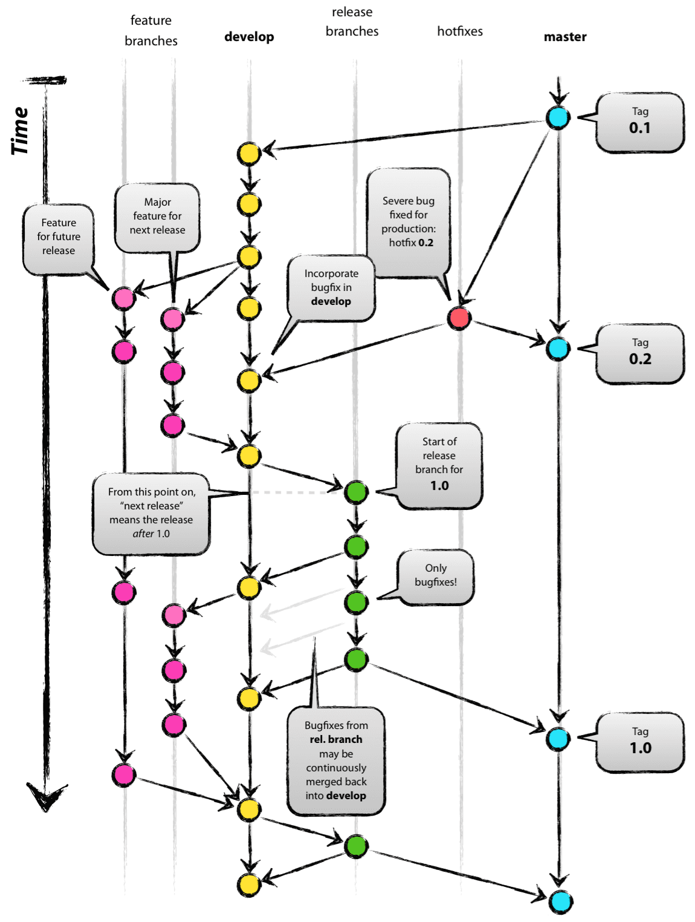

Computergebruik
git branches

Slide 2
Branching

Slide 3

Git storage model
Auteurs
-------
Alice
Auteurs
-------
Alice
Bob
Auteurs
-------
Alice
$ nano README
$ sha1sum README
65a5e7898d2394200ed8b2b74b629f9647c1f1b5 README
$ nano README
$ sha1sum README
c0eadf2ebda4489c1192befb624f0ad4b4865311 README
$ nano README
$ sha1sum README
65a5e7898d2394200ed8b2b74b629f9647c1f1b5 README

Slide 4
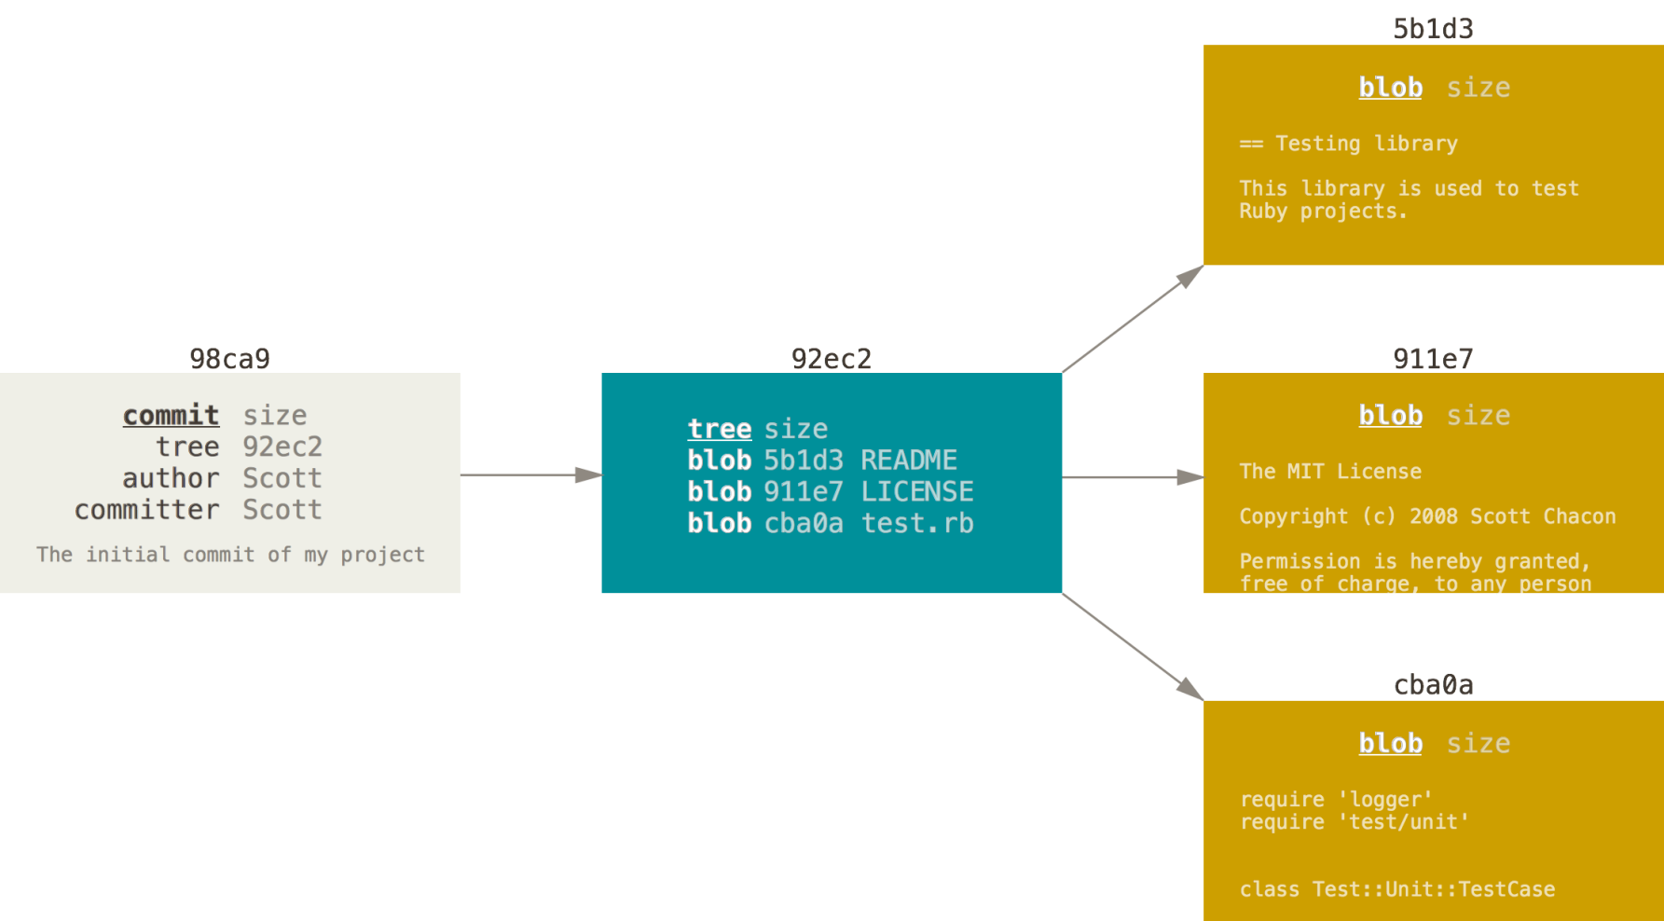
Git storage model
$ git add README LICENSE test.rb
$ git commit -m 'The initial commit of my project'

Slide 5
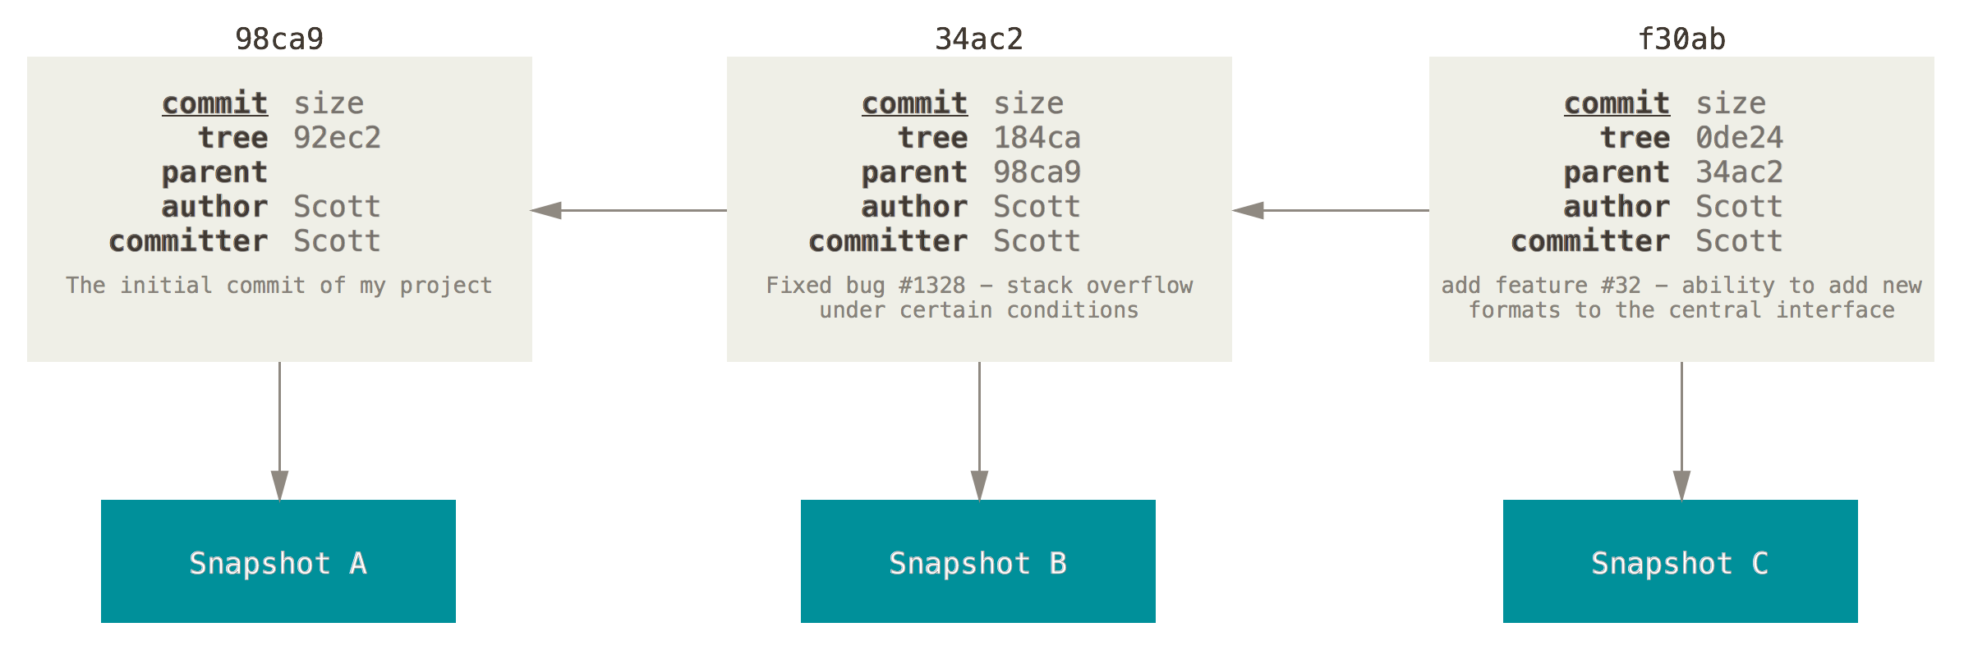
Git storage model
$ git commit -m 'Fixed bug #1328 – stack overf...
$ git commit -m 'add feature #32 – ability to ...

Slide 6
Git branches
HEAD
master
98ca9
34ac2
f30ab
testing
snapshot A
snapshot B
snapshot C
$ git branch testing
$ git log --oneline --decorate
f30ab (HEAD, master, testing) add feature #32 - ability to add new
34ac2 fixed bug #1328 - stack overflow under certain conditions
98ca9 initial commit of my project

Slide 7
Git branches
HEAD
master
98ca9
34ac2
f30ab
testing
c2b9e
HEAD
testing
HEAD
$ git checkout testing
$ vim test.rb
$ git commit -a -m 'made a change'

Slide 8
Git branches
HEAD
HEAD
master
master
87ab2
98ca9
34ac2
f30ab
c2b9e
testing
HEAD
$ git checkout master
$ vim test.rb
$ git commit -a -m 'made other changes'

Slide 9
Git branches
HEAD
master
87ab2
98ca9
34ac2
f30ab
c2b9e
testing
$ git log --oneline --decorate --graph --all
* c2b9e (HEAD, master) made other changes
| * 87ab2 (testing) made a change
|/
* f30ab add feature #32 - ability to add new formats to the
* 34ac2 fixed bug #1328 - stack overflow under certain conditions
* 98ca9 initial commit of my project

Slide 10
Branches samenvoegen
master
master
C0
C1
C2
iss53
iss53
$ git branch iss53
$ git checkout iss53

Slide 11
Branches samenvoegen
master
C0
C1
C2
iss53
C3
iss53
$ git checkout -b iss53
Switched to a new branch "iss53"
$ vim index.html
$ git commit -a -m 'added a new footer [issue 53]'

Slide 12
Branches samenvoegen
master
master
hotfix
C0
C1
C2
C4
hotfix
hotfix
C3
iss53
iss53
$ git checkout master
Switched to branch 'master'
$ git checkout -b hotfix
Switched to a new branch 'hotfix'
$ vim index.html
$ git commit -a -m 'fixed the broken email address'

Slide 13
Branches samenvoegen
master
master
master
hotfix
hotfix
C0
C1
C2
C4
C3
iss53
$ git checkout master
$ git merge hotfix
Updating f42c576..3a0874c
Fast-forward
index.html | 2 ++
1 file changed, 2 insertions(+)

Slide 14
Branches samenvoegen
master
hotfix
C0
C1
C2
C4
C3
iss53
$ git branch -d hotfix
Deleted branch hotfix (3a0874c).

Slide 15
Branches samenvoegen
master
master
C0
C1
C2
C4
C3
C5
iss53
iss53
iss53
$ git checkout iss53
Switched to branch "iss53"
$ vim index.html
$ git commit -am 'finished the new footer [issue 53]'
[iss53 ad82d7a] finished the new footer [issue 53]
1 file changed, 1 insertion(+)

Slide 16
Branches samenvoegen
gemeenschappelijke
voorouder
master
snapshot waarin moet
samengevoegd worden
master
master
C0
C1
C2
C2
C4
C4
C6
C3
C5
C5
snapshot die moet
samengevoegd
worden
iss53
iss53
$ git checkout master
Switched to branch 'master'
$ git merge iss53
Merge made by the 'recursive' strategy.
README | 1 +
1 file changed, 1 insertion(+)

Slide 17
Branches samenvoegen
master
C0
C1
C2
C4
C6
C3
C5
iss53
$ git branch -d iss53

Slide 18
Eenvoudige mergeconflicten
gemeenschappelijke
voorouder
master
snapshot waarin moet
samengevoegd worden
C0
C1
C2
C2
C4
C4
C3
C5
C5
snapshot die moet
samengevoegd
worden
iss53
$ git merge iss53
Auto-merging index.html
CONFLICT (content): Merge conflict in index.html
Automatic merge failed; fix conflicts and then commit the result.

Slide 19
Eenvoudige mergeconflicten
gemeenschappelijke
voorouder
master
snapshot waarin moet
samengevoegd worden
C0
C1
C2
C2
C4
C4
C3
C5
C5
snapshot die moet
samengevoegd
worden
iss53
$ git status
On branch master
You have unmerged paths.
(fix conflicts and run "git commit")
Unmerged paths:
(use "git add <file>..." to mark resolution)
both modified: index.html
no changes added to commit (use "git add" and/or "git commit -a")
<<<<<<< HEAD:index.html
<div id="footer">contact : email.support@github.com</div>
=======
<div id="footer">
please contact us at support@github.com
</div>
>>>>>>> iss53:index.html

Slide 20
Eenvoudige mergeconflicten
gemeenschappelijke
voorouder
master
snapshot waarin moet
samengevoegd worden
C0
C1
C2
C2
C4
C4
C3
C5
C5
snapshot die moet
samengevoegd
worden
iss53
$ git status
On branch master
You have unmerged paths.
(fix conflicts and run "git commit")
Unmerged paths:
(use "git add <file>..." to mark resolution)
both modified: index.html
no changes added to commit (use "git add" and/or "git commit -a")
<div id="footer">
please contact us at support@github.com
</div>

Slide 21
Eenvoudige mergeconflicten
Merge branch 'iss53'
Conflicts:
index.html
#
# It looks like you may be committing a merge.
# If this is not correct, please remove the file
# .git/MERGE_HEAD
# and try again.
# Please enter the commit message for your changes. Lines starting
# with '#' will be ignored, and an empty message aborts the commit.
# On branch master
# All conflicts fixed but you are still merging.
#
# Changes to be committed:
# modified: index.html
#
gemeenschappelijke
voorouder
master
snapshot waarin moet
samengevoegd worden
C0
C1
C2
C2
C4
C4
C3
C5
C5
snapshot die moet
samengevoegd
worden
iss53
$ git add index.html
$ git status
On branch master
All conflicts fixed but you are still merging.
(use "git commit" to conclude merge)
Changes to be committed:
modified: index.html
$ git commit

Slide 22
Eenvoudige mergeconflicten
gemeenschappelijke
voorouder
master
snapshot waarin moet
samengevoegd worden
master
C0
C1
C2
C2
C4
C4
C6
C3
C5
C5
snapshot die moet
samengevoegd
worden
iss53
iss53
$ git add index.html
$ git status
On branch master
All conflicts fixed but you are still merging.
(use "git commit" to conclude merge)
Changes to be committed:
modified: index.html
$ git commit

Slide 23
Branch management
testing
C6
C7
master
C0
C1
C2
C4
C8
C3
C5
iss53
$ git branch
iss53
* master
testing

Slide 24
Branch management
testing
C6
C7
master
C0
C1
C2
C4
C8
C3
C5
iss53
$ git branch -v
iss53 93b412c fix javascript issue
* master 7a98805 Merge branch 'iss53'
testing 782fd34 add scott to the author list in the readmes

Slide 25
Branch management
testing
C6
C7
master
C0
C1
C2
C4
C8
C3
C5
iss53
$ git branch --merged
iss53
* master
$ git branch -d iss53

Slide 26
Branch management
testing
C6
C7
master
C0
C1
C2
C4
C8
C3
C5
$ git branch --no-merged
testing
$ git branch -d testing
error: The branch 'testing' is not fully merged.
If you are sure you want to delete it, run 'git branch -D testing'.
$ git branch -D testing

Slide 27
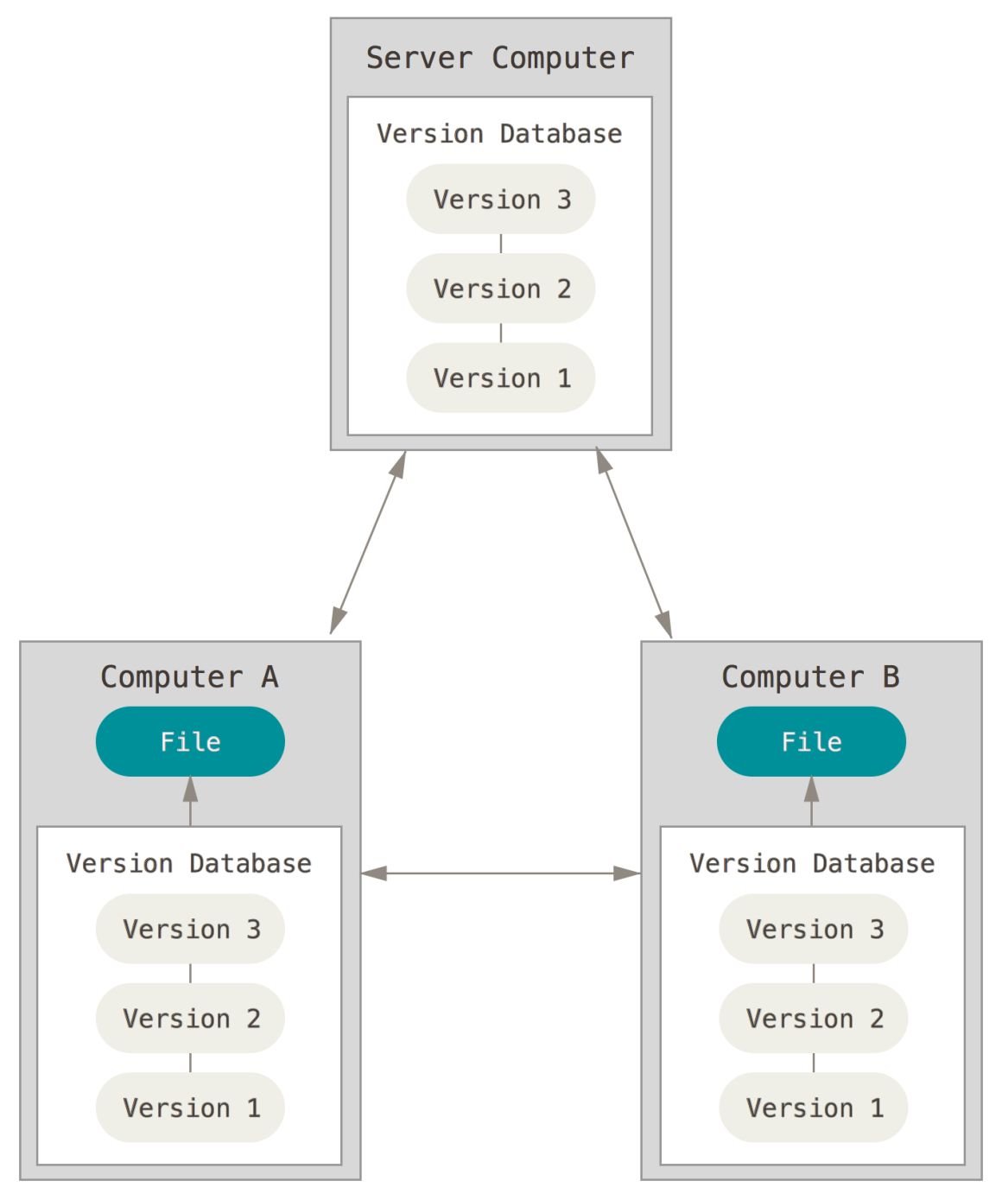
Werken met remotes

Slide 28
Remotes bekijken
$ git clone https://github.com/schacon/ticgit
Cloning into 'ticgit'...
remote: Reusing existing pack: 1857, done.
remote: Total 1857 (delta 0), reused 0 (delta 0)
Receiving objects: 100% (1857/1857), 374.35 KiB | 268.00 KiB/s, done.
Resolving deltas: 100% (772/772), done.
Checking connectivity... done.
$ cd ticgit
$ git remote
origin
$ git remote -v
origin https://github.com/schacon/ticgit (fetch)
origin https://github.com/schacon/ticgit (push)

Slide 29
Remotes bekijken
$ cd grit
$ git remote -v
bakkdoor https://github.com/bakkdoor/grit (fetch)
bakkdoor https://github.com/bakkdoor/grit (push)
cho45 https://github.com/cho45/grit (fetch)
cho45 https://github.com/cho45/grit (push)
defunkt https://github.com/defunkt/grit (fetch)
defunkt https://github.com/defunkt/grit (push)
koke git://github.com/koke/grit.git (fetch)
koke git://github.com/koke/grit.git (push)
origin git@github.com:mojombo/grit.git (fetch)
origin git@github.com:mojombo/grit.git (push)

Slide 30
Remotes toevoegen
alice
remote.git
origin (fetch)
origin (pull)
~$ git clone --bare --shared alice remote.git
Cloning into bare repository 'remote.git'...
done.
~$ cd alice
alice$ git remote add origin ../remote.git
alice$ git remote -v
origin ../remote.git (fetch)
origin ../remote.git (push)

Slide 31
Remotes toevoegen
alice
remote.git
bob
origin (fetch)
origin (fetch)
origin (pull)
origin (pull)
~$ mkdir bob
~$ cd bob
bob$ git init
Initialized empty Git repository in ~/bob/.git/
bob$ git remote add origin ../remote.git/
bob$ git remote -v
origin ../remote.git/ (fetch)
origin ../remote.git/ (push)

Slide 32
Pushen naar remotes
alice
remote.git
bob
origin (fetch)
origin (fetch)
origin (pull)
origin (pull)
alice$ git push origin master
Total 0 (delta 0), reused 0 (delta 0)
To ../remote.git
3936948..4cdda8c master -> master

Slide 33
Fetchen van remotes
alice
remote.git
bob
origin (fetch)
origin (fetch)
origin (pull)
origin (pull)
alice$ git push origin master
Total 0 (delta 0), reused 0 (delta 0)
To ../remote.git
3936948..4cdda8c master -> master
bob$ git fetch origin
remote: Counting objects: 3, done.
remote: Total 3 (delta 0), reused 0 (delta 0)
Unpacking objects: 100% (3/3), done.
From ../remote
* [new branch] master -> origin/master
$ git branch -vv
* master 3936948 [origin/master: behind 1] eerste commit

Slide 34
Remotes inspecteren
alice
remote.git
bob
origin (fetch)
origin (fetch)
origin (pull)
origin (pull)
bob$ git remote show origin
* remote origin
Fetch URL: ../remote.git/
Push URL: ../remote.git/
HEAD branch: master
Remote branch:
master tracked
Local branch configured for 'git pull':
master merges with remote master
Local ref configured for 'git push':
master pushes to master (local out of date)

Slide 35
Pullen van remotes
alice
remote.git
bob
origin (fetch)
origin (fetch)
origin (pull)
origin (pull)
bob$ git pull
Updating 3936948..4cdda8c
Fast-forward
README | 3 +++
1 file changed, 3 insertions(+)
bob$ cat README
auteurs
-------
Alice

Slide 36
Remotes verwijderen en hernoemen
alice
remote.git
bob
origin (fetch)
origin (fetch)
bron (fetch)
origin (pull)
origin (pull)
bron (pull)
bob$ git remote rename origin bron
bob$ git remote -vv
bron ../remote.git/ (fetch)
bron ../remote.git/ (push)
bob$ git remote rm bron
bob$ git remote -vv

Slide 37
Labels
$ git tag
v0.1
v1.3
$ git clone https://github.com/git/git.git
$ cd git
$ git tag -l 'v1.8.5*’
v1.8.5
v1.8.5-rc0
v1.8.5-rc1
v1.8.5-rc2
v1.8.5-rc3
v1.8.5.1
v1.8.5.2
v1.8.5.3
v1.8.5.4
v1.8.5.5

Slide 38
Annoted tags
$ git tag -a v1.4 -m 'my version 1.4'
$ git tag
v0.1
v1.3
v1.4
$ git show v1.4
tag v1.4
Tagger: Ben Straub <ben@straub.cc>
Date: Sat May 3 20:19:12 2014 -0700
my version 1.4
commit ca82a6dff817ec66f44342007202690a93763949
Author: Scott Chacon <schacon@gee-mail.com>
Date: Mon Mar 17 21:52:11 2008 -0700
changed the version number

Slide 39
Lightweight tags
$ git tag v1.4-lw
$ git tag
v0.1
v1.3
v1.4
v1.4-lw
$ git show v1.4-lw
commit ca82a6dff817ec66f44342007202690a93763949
Author: Scott Chacon <schacon@gee-mail.com>
Date: Mon Mar 17 21:52:11 2008 -0700
changed the version number

Slide 40
Achteraf labels toekennen
$ git log --pretty=oneline
15027957951b64cf874c3557a0f3547bd83b3ff6 Merge branch 'experiment'
a6b4c97498bd301d84096da251c98a07c7723e65 beginning write support
0d52aaab4479697da7686c15f77a3d64d9165190 one more thing
6d52a271eda8725415634dd79daabbc4d9b6008e Merge branch 'experiment'
0b7434d86859cc7b8c3d5e1dddfed66ff742fcbc added a commit function
4682c3261057305bdd616e23b64b0857d832627b added a todo file
166ae0c4d3f420721acbb115cc33848dfcc2121a started write support
9fceb02d0ae598e95dc970b74767f19372d61af8 updated rakefile
964f16d36dfccde844893cac5b347e7b3d44abbc commit the todo
8a5cbc430f1a9c3d00faaeffd07798508422908a updated readme
$ git tag -a v1.2 9fceb02
$ git tag
v0.1
v1.2
v1.3
v1.4
v1.4-lw

Slide 41
Labels delen
$ git push origin
$ git push origin v1.5
Counting objects: 14, done.
Delta compression using up to 8 threads.
Compressing objects: 100% (12/12), done.
Writing objects: 100% (14/14), 2.05 KiB | 0 bytes/s, done.
Total 14 (delta 3), reused 0 (delta 0)
To git@github.com:schacon/simplegit.git
* [new tag] v1.5 -> v1.5
$ git push origin --tags
Counting objects: 1, done.
Writing objects: 100% (1/1), 160 bytes | 0 bytes/s, done.
Total 1 (delta 0), reused 0 (delta 0)
To git@github.com:schacon/simplegit.git
* [new tag] v1.4 -> v1.4
* [new tag] v1.4-lw -> v1.4-lw

Slide 42
Checkout van tags
$ git checkout -b version2 v2.0.0
Switched to a new branch 'version2'

Slide 43
Git aliassen
$ git config --global alias.co checkout
$ git config --global alias.br branch
$ git config --global alias.ci commit
$ git config --global alias.st status
$ git config --global alias.unstage 'reset HEAD --'
$ git unstage fileA
$ git reset HEAD fileA
$ git config --global alias.last 'log -1 HEAD'
$ git last
commit 66938dae3329c7aebe598c2246a8e6af90d04646
Author: Josh Goebel <dreamer3@example.com>
Date: Tue Aug 26 19:48:51 2008 +0800
test for current head
Signed-off-by: Scott Chacon <schacon@example.com>

Slide 44
Remote branches
git.ourcompany.com
master
0b743
a6b4c
f4265
$ git clone janedoe@git.ourcompany.com:project.git
mijn computer
origin
master
0b743
a6b4c
f4265
origin/
master

Slide 45
Remote branches
git.ourcompany.com
master
0b743
a6b4c
f4265
31b8e
190a3
mijn computer
origin
master
0b743
a6b4c
f4265
origin/
master

Slide 46
Remote branches
git.ourcompany.com
master
0b743
a6b4c
f4265
31b8e
190a3
mijn computer
origin
master
0b743
a6b4c
f4265
a38de
893cf
origin/
master

Slide 47
Remote branches
git.ourcompany.com
master
0b743
a6b4c
f4265
31b8e
190a3
$ git fetch origin
mijn computer
origin
master
0b743
a6b4c
f4265
a38de
893cf
origin/
master
31b8e
190a3
origin/
master

Slide 48
Remote branches
git.ourcompany.com
master
git.team1.ourcompany.com
master
f4265
31b8e
190a3
f4265
31b8e
$ git remote add teamone git://git.team1.ourcompany.com
mijn computer
origin
teamone
master
0b743
a6b4c
f4265
a38de
893cf
31b8e
190a3
origin/
master

Slide 49
Remote branches
git.ourcompany.com
master
git.team1.ourcompany.com
master
f4265
31b8e
190a3
f4265
31b8e
$ git fetch teamone
mijn computer
origin
teamone
master
0b743
a6b4c
f4265
a38de
893cf
31b8e
190a3
teamone/
master
origin/
master

Slide 50

Vragen of opmerkingen ?

Slide 51
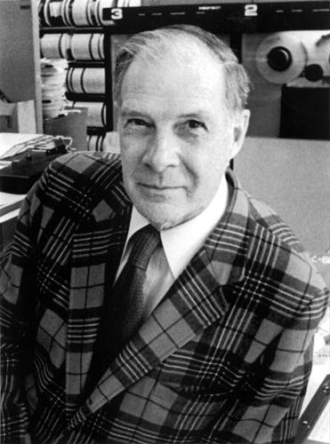
The sky is the limit…
RW Hamming
1915-1998
"... but for students, numbers are
often the best road to insight."
"The purpose of computing is
insight, not numbers..."
⎯ R.W. Hamming
⎯ A. Ralston

